Slide 1
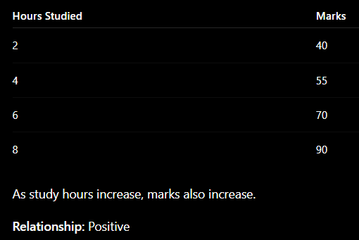
UNIT – IV
Relationships Between Two Variables
Definition
Relationship between two variables means how one variable changes when another variable changes.
If one increases and the other also increases → Positive relationship
If one increases and the other decreases → Negative relationship
If there is no pattern → No relationship

Slide 2
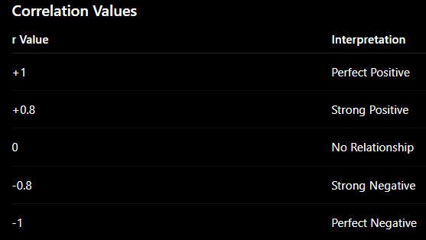
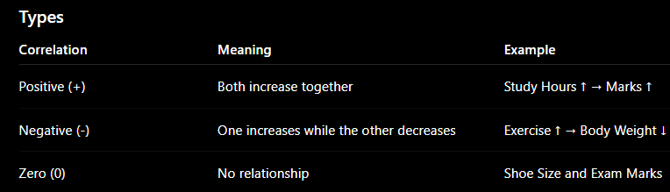
Key Concepts
1. Correlation
Definition
Correlation measures the strength and direction of the relationship between two numerical variables.

Slide 3
2. Causation
Definition
Causation means one variable directly causes changes in another variable.
Example
More Fertilizer → Better Crop Yield
Here fertilizer directly affects crop growth.
Important Point
Correlation does not always mean causation.
Example:
Ice Cream Sales ↑ and Drowning Cases ↑
Both increase during summer, but ice cream does not cause drowning.

Slide 4
3. Association
Definition
Association means two variables are related, but one may not necessarily cause the other.
Example
Umbrella Sales ↑ and Rainfall ↑
Rain increases umbrella sales.
There is an association.
4. Independence
Definition
Two variables are independent if one variable does not affect the other.
Example
Student Roll Number and Height
These variables have no relationship.

Slide 5
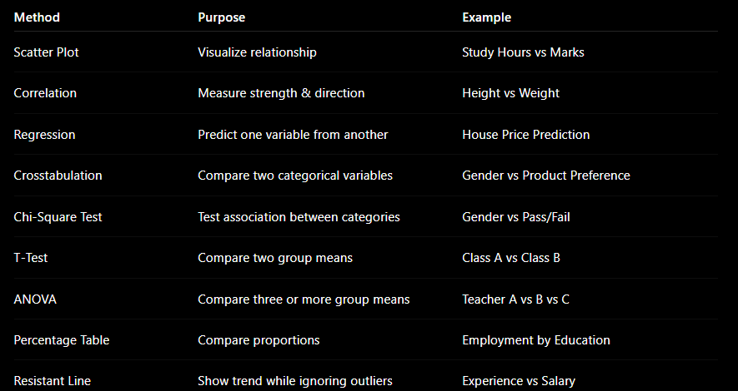

Slide 6
Percentage Tables in Bivariate Analysis Percentage tables (also known as proportion tables or relative frequency tables) are used to understand the distribution and relationship between two categorical variables.
They provide a clear and concise way to visualize the proportion of observations in each category combination of the two variables.
These tables help in identifying patterns, associations, and potential dependencies between the variables.
Key Concepts
Frequency Table: A table that displays the count of occurrences for each combination of categories in two categorical variables.
Percentage Table: A table that converts the counts from a frequency table into percentages, making it easier to interpret the proportions.
Row Percentage Table: Shows the percentage of each row category within the corresponding column categories.
Column Percentage Table: Shows the percentage of each column category within the corresponding row categories.
Overall Percentage Table: Shows the percentage of each cell relative to the total number of observations.

Slide 7
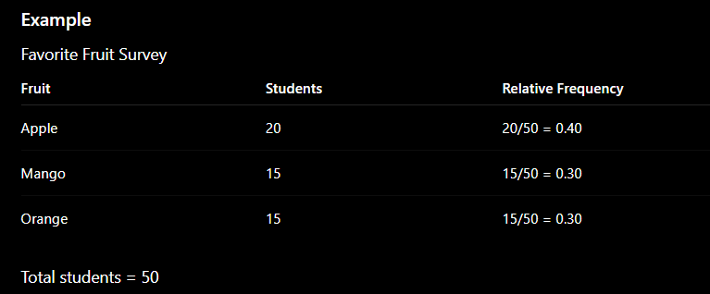
Relative Frequency Distribution
Definition
Relative frequency is the proportion of observations in each category.
Formula
Relative Frequency = Frequency / Total Frequency

Slide 8
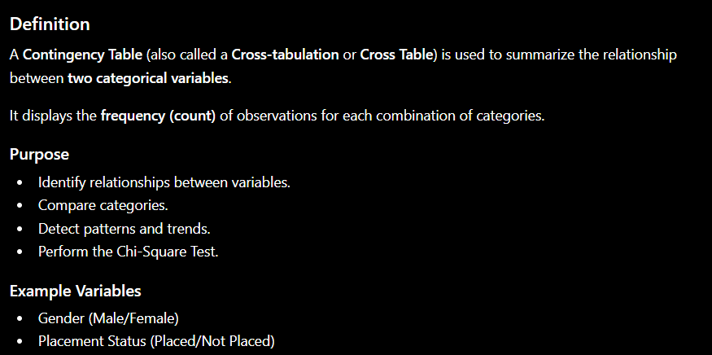

Slide 9
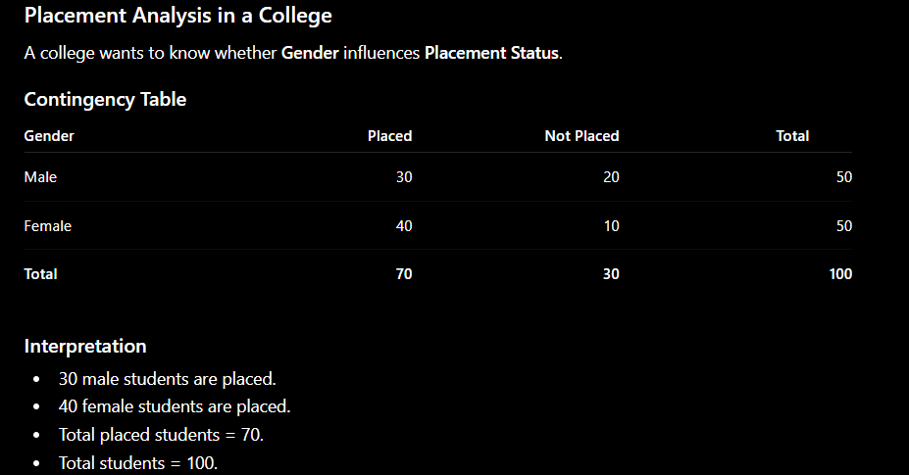

Slide 10
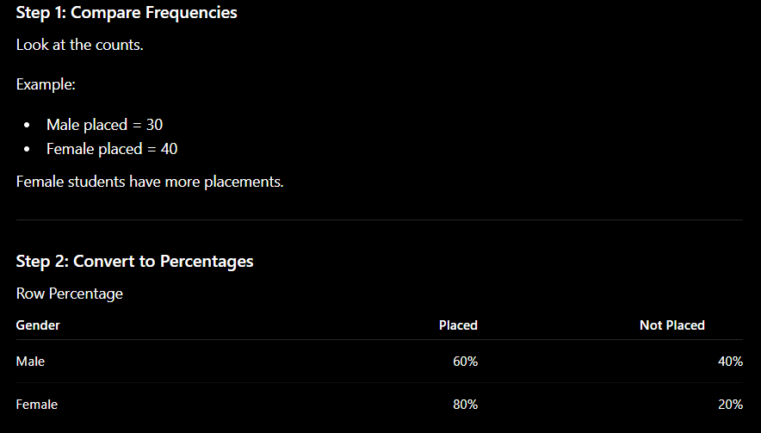

Slide 11
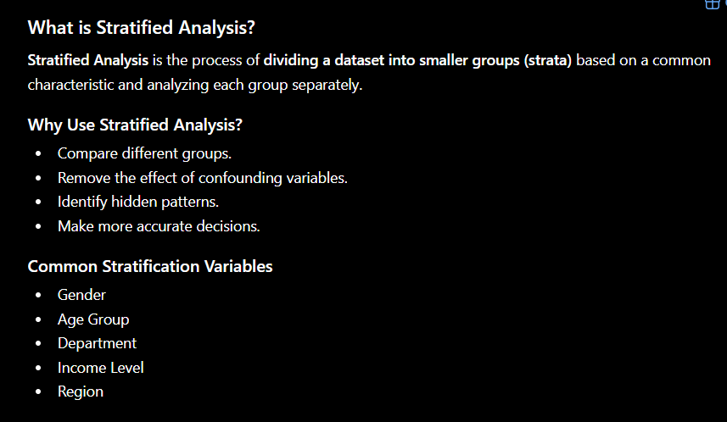

Slide 12
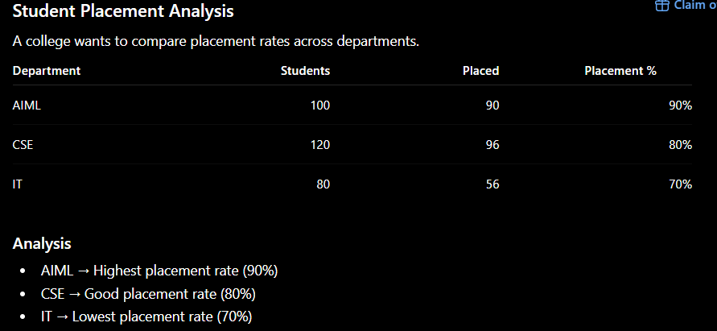

Slide 13
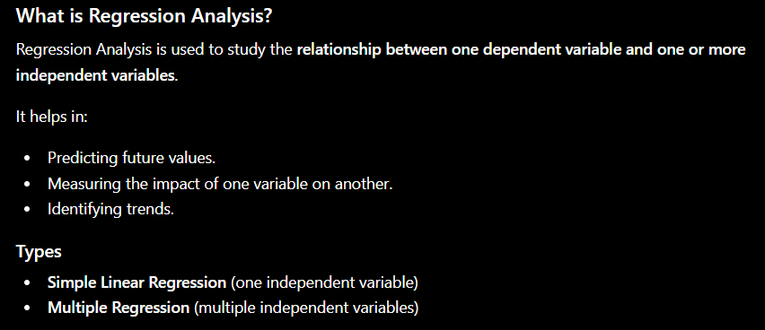

Slide 14
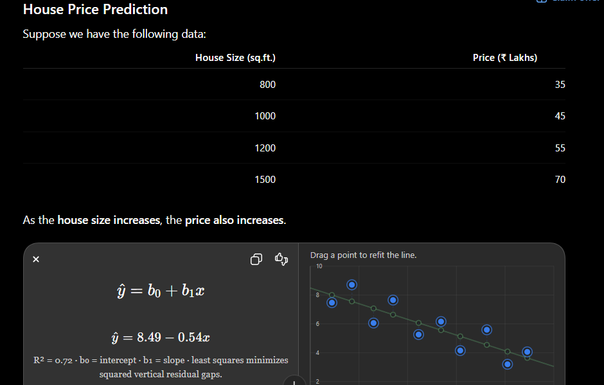
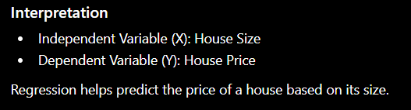

Slide 15
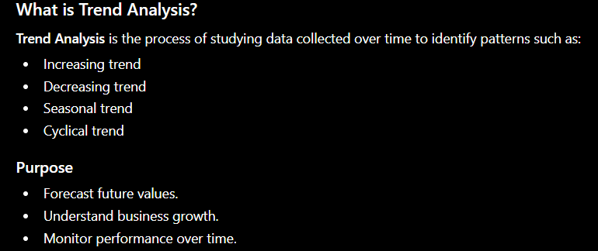

Slide 16
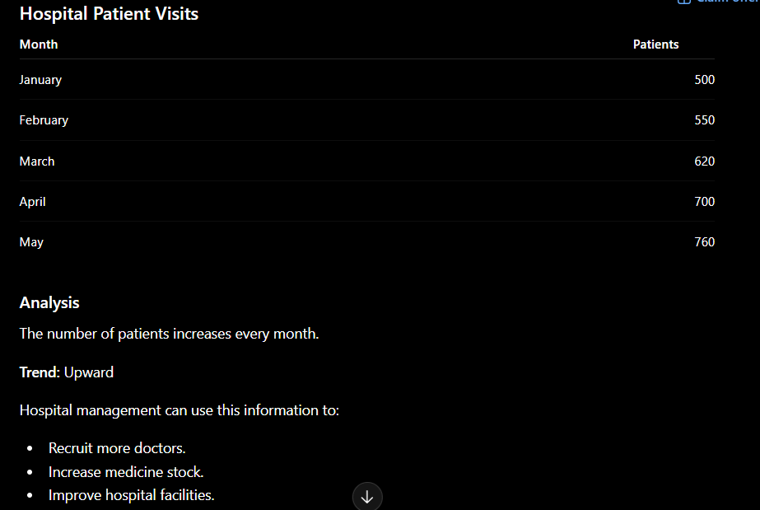

Slide 17
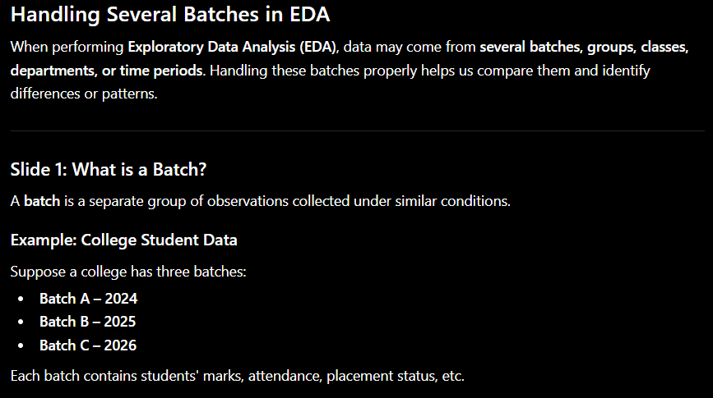

Slide 18
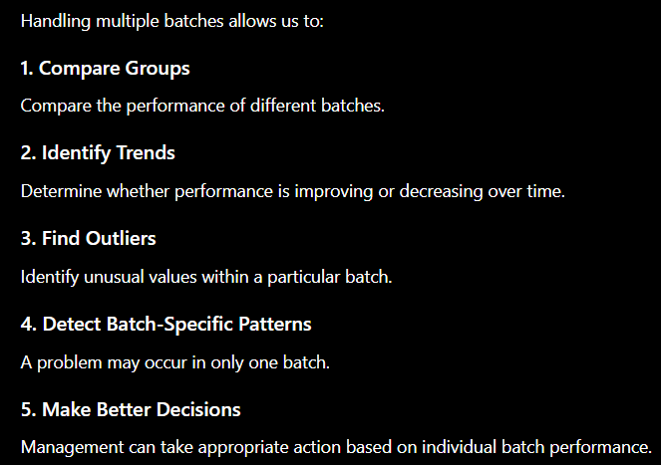
Why Handle Several Batches?

Slide 19
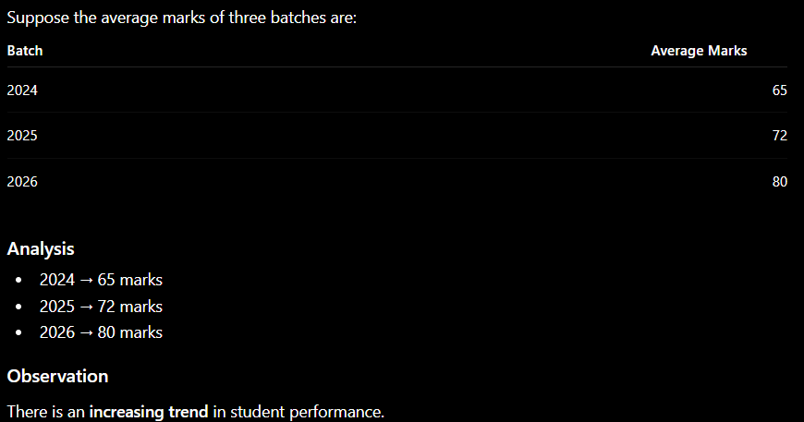
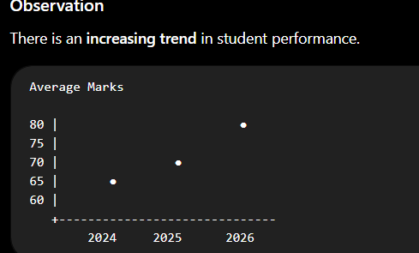

Slide 20
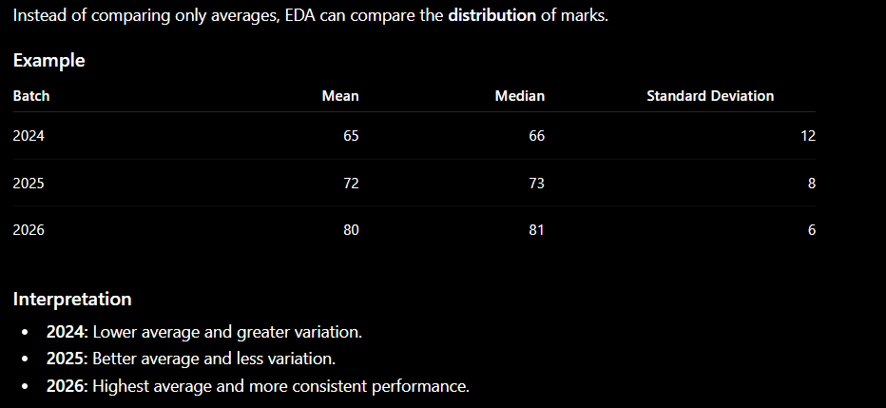
Compare Distribution Across Batches

Slide 21
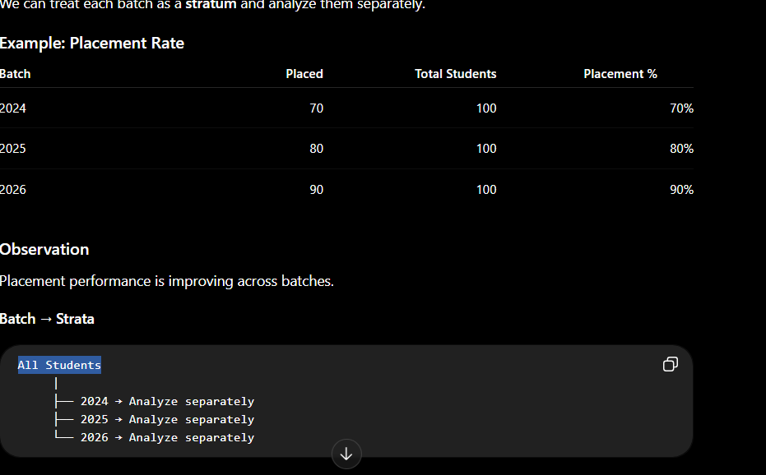
Handling Several Batches Using Stratified Analysis

Slide 22
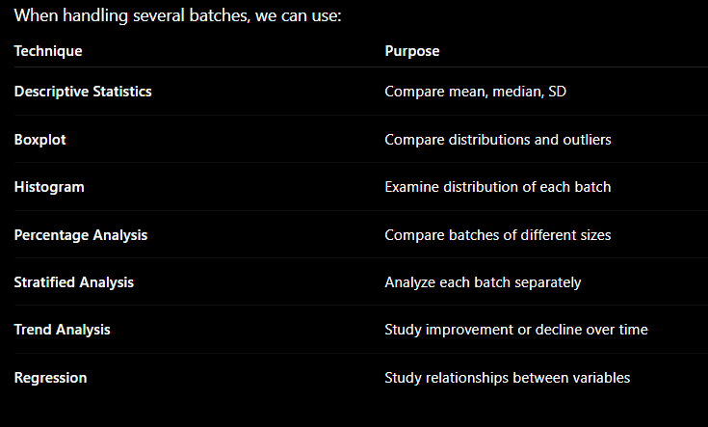
Key EDA Techniques for Multiple Batches

Slide 23
Resistant Lines in EDA
1. What is a Resistant Line?
A resistant line is a regression line designed to show the central trend of the data without being strongly affected by extreme values (outliers).
It is also called a robust regression line.
Simple Meaning
A resistant line tries to represent the majority of the data, rather than allowing a few unusual observations to pull the line toward them.

Slide 24
Why Do We Need Resistant Lines?
Consider a dataset showing:
House Size vs House Price
Most houses follow a normal pattern:
Small house → Lower price
Large house → Higher price
But suppose one luxury house has an extremely high price.
A traditional least-squares regression line can be pulled toward this unusual house.
A resistant line reduces the influence of that outlier.

